Slide 1
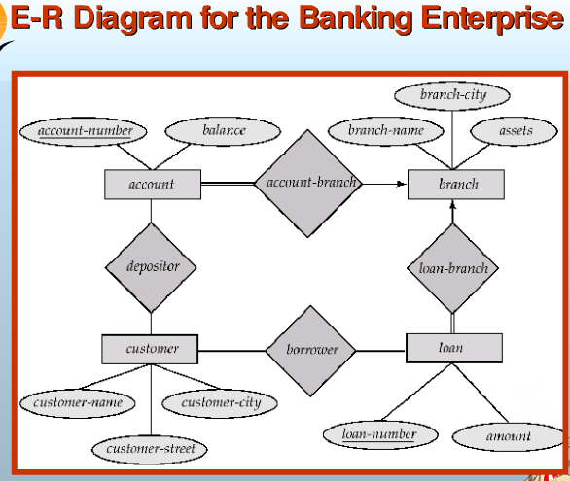
IT1768 - Database Systems
Topic 5 :
Entity-Relationship Modelling
click hyperlink below:
https://www.youtube.com/watch?v=IfaqkiHpIjo

Slide 2
Unit 5 : Entity-Relationship Modelling
Objective :
At the end of this unit, you should be able to:
  classify the elements in the relational model.
  explain the process of entity-relationship modelling
  execute modelling on 1:1, 1:N and M:N relationships.

Slide 3
Entity-Relationship Modelling (ERM)
1) By relational model, an primitive Entity Relationship Diagram (ERD) can be established – with entities, attributes and relationships (with cardinalities based on the business processes)
VEHICLES
EMPLOYEES
PROJECTS
VehNum(PK)
EmpID(PK)
EmpName
Professions
ChargeRate
ProjCode(PK)
ProjTitle
ProjCost
ProjMgr
own
handle
VehModel
DateRegister
Question:
How to produce a completely modelled ER diagram?
work
on
reports
DEPARTMENT
DepNo(PK)
DepName
DepMgr
SITES
Solution:
Perform modelling by the relationships in ERD
SiteNo(PK)
Location
Area

Slide 4
Entity-Relationship Modelling (ERM)
A modelled Entity Relationship Diagram:
Closely resemble with ER diagram, a modelled relational entity diagram should contain :
Entities, Attributes
Relationships with cardinalities
Insertion of foreign keys in the child entity and hence, establish a relationship between primary and foreign keys in the adjacent entities.
EMPLOYEE
EmpID(PK)
EmpName
Professions
ChargeRate
Department
(PK)
DEPARTMENT
DepNo(PK)
DepName
DepMgr
Work
(PK)
(FK)
DepNum
Entity: DEPARTMENT
Entity: EMPLOYEES
Notes:
Let’s start this topic with this question:
Why should there a need for ER modelling?
Firstly, we must know that the primitive ER diagram is a conceptual ER Diagram, the attributes in the entities may not be comprehensive with the relationship or may not be detailed enough to represent the real-world operations.
By its relationships, there is a need for it to be modelled so that it becomes more logical with primary key and foreign key inter-connected in a relationship and hence, it can represent the real-world operations more precisely.
ER model would comprise of the following 3 items:
entities, attributes and
Relationships
Primary and foreign key attributes are being linked by the relationships.

Slide 5
Recap on cardinality - maximum & minimum values
ER Modelling focuses on the maximum cardinalities at each end of the tie:
1:N (one-to-many) relationship
EMPLOYEES
EmpID
EmpName
Professions
ChargeRate
M:N (many-to-many) relationship
N
Max cardinality
Max cardinality
EMPLOYEES
PROJECTS
Min cardinality
N
EmpID
EmpName
Professions
ChargeRate
ProjCode
ProjTitle
ProjCost
ProjMgr
Min cardinality
1
Maximum cardinality
handles
M
SITES
Maximum cardinality
SiteNo
Location
Area

Slide 6
Entity relationship diagram is modelled based on the following relationships between entities:
Different Types of Relationships in ERD
One-and-Only-One
One-and-Many
(Many to one)
EMPLOYEES
Receive
PAYCHECK
CUSTOMERS
Set Up
ACCOUNTS
or
or
Many-to-Many
STUDENTS
Enroll
MODULES
or

Slide 7
Different Types of Relationships in ERD
E R Modelling deals with 3 types of relationships:
a) 1:1 (one-to-one relationship)
EMPLOYEES
b) 1:N (one-to-many relationship)
VEHICLES
EmpID
EmpName
Professions
ChargeRate
VehNum
owns
EMPLOYEES
PROJECTS
VehModel
EmpID
EmpName
Professions
ChargeRate
ProjCode
ProjTitle
ProjCost
ProjMgr
DateRegister
c) M:N (many-to-many relationship)
reports
on
EMPLOYEES
PROJECTS
EmpID
EmpName
Professions
ChargeRate
SITES
SITES
handles
ProjCode
ProjTitle
ProjCost
ProjMgr
SiteNo
Location
Area
SiteNo
Location
Area

Slide 8
1 : 1 Relationship Modelling
A one-to-one relationship is where each record in the destination entity is related to one record in the source entity.
Example : Modelling between an VEHICLES and EMPLOYEES entities
VEHICLES
VehNum (PK)
VehModel
DateRegister
EMPLOYEES
EmpID (PK)
EmpName
Profession
ChargeRate
owns
Entity: VEHICLES
Entity: EMPLOYEES

Slide 9
1 : 1 Relationship Modelling
Modelling rule for 1:1 relationship:
In 1:1 relationship modelling, the key of either entity can be placed as a foreign key in the other entity.
2 Key attributes in the example:
VEHICLES entity – ‘VehNum’, EMPLOYEES entity – ‘EmpID’,
Two possible options of key placement :
Option 1 : Place ‘EmpID’ under the VEHICLES entity
Option 2 : Place ‘VehNum’ under the EMPLOYEES entity
(Option 1)
(Option 2)
EMPLOYEES
EmpID (PK)
EmpName
Profession
ChargeRate
VEHICLES
VehNum (PK)
VehModel
DateRegister
EMPLOYEES
EmpID (PK)
EmpName
Profession
ChargeRate
VEHICLES
VehNum (PK)
VehModel
DateRegister
EmpID
VehNum
Which option is more viable?

Slide 10
1 : 1 Relationship Modelling
Option 1 is more rational, because it implies that any vehicle is owned by an employee and,
Option 2 implies that every employee owns a vehicle which may not be true for all. E.g. a low income employee may not own a vehicle.
Hence, the modelled relationship should be:
Action word
Cardinalities
VEHICLES
VehNum (PK)
VehModel
DateRegister
EMPLOYEES
EmpID (PK)
EmpName
Profession
ChargeRate
owns
(PK)
(FK)
EmpID
Entity: VEHICLES
Relationship
Entity: EMPLOYEES
Relation Schemas:
New !
VEHICLES ( VehNum, VehModel, DateRegister, EmpID )
EMPLOYEES ( EmpID, EmpName, Professions, ChargeRate )

Slide 11
1 : 1 Relationship Modelling
Modelled relations are as shown:
Entity: VEHICLES
(FK)
(Inserted FK by modelling)
(PK)
VehNum | VehModel | DateRegister | EmpID
SLM1111A | Toyata Vios | 18-Jan-2012 | E-02
SLK2222B | Volvo S6 | 30-Mar-2013 | E-03
SLL3333C | BMW 523 | 20-May-2015 | E-04
Relation Schemas:
VEHICLES ( VehNum, VehModel, DateRegister, EmpID )
Entity: EMPLOYEES
(PK)
EmpID | EmpName | Profession | ChargeRate
E-01 | Aaron | Designer | $50
E-02 | Ben | Engineer | $60
E-03 | Chris | Programmer | $75
E-04 | Doris | Consultant | $100
EMPLOYEES ( EmpID, EmpName, Professions, ChargeRate, Department )

Slide 12
1 : Many Relationship Modelling
In a one-to-many (1:N) relationship, each record (1-sided) in the related entity can be related to many records (N-sided) in the relating entity.
Example : Modelling between the PROJECTS and SITES entities
PROJECTS
ProjCode(PK)
ProjTitle
ProjCost
ProjMgr
SITES
SiteNo(PK)
Location
Area
Build
Entity: SITES
Entity: PROJECTS

Slide 13
1 : Many Relationship Modelling
Rule for 1:N relationship:
In 1:N relationship modeling, it should insert a foreign key (FK) into the N-side entity. This FK should come from the primary key of the 1-side entity.
2 Key attributes in the example:
PROJECTS entity – ‘ProjCode’, SITES entity – ‘SiteNo’
PROJECTS
ProjCode(PK)
ProjTitle
ProjCost
ProjMgr
SITES
SiteNo(PK)
Location
Area
Build
Entity: SITES
Entity: PROJECTS
By the rule, it should insert ‘SiteNo’ into PROJECT entity (N-side).

Slide 14
1 : Many Relationship Modelling
Hence, the modelled relationship should be:
PROJECTS
ProjCode(PK)
ProjTitle
ProjCost
ProjMgr
Build
SITES
SiteNo(PK)
Location
Area
(PK)
(FK)
SiteNo
Entity: SITES
Entity: PROJECTS
Relation Schemas:
PROJECTS ( ProjCode, ProjTitle, ProjCost, ProjMgr, SiteNo )
SITES ( SiteNo, Location, Area )
Notes:
During the modelling, it involves not only appending ‘SiteNo’ from ‘SITES’ entity to the ‘PROJECTS” entity, the relationship is also to be re-aligned in such way the it links to both the primary and the foreign keys. (as shown in the slide) (Click)
To write the relation schema, the ‘PROJECTS’ relation will have one additional attribute - that is ‘SiteNo’ in it.

Slide 15
1 : Many Relationship Modelling
Modelled relations are as shown:
Entity: PROJECTS
(Inserted FK by modelling)
(PK)
ProjCode | ProjTitle | ProjCost | ProjMgr | SiteNo
PJ-111A | AA Mall | $2,012,000 | Robinson | ST-02
PJ-222B | BB Mansion | $3,013,000 | John | ST-03
PJ-333C | CC-IT Centre | $3,015,000 | Mark | ST-04
(FK)
Relation Schemas:
PROJECTS ( ProjCode, ProjTitle, ProjCost, ProjMgr, SiteNo )
Entity: SITES
(PK)
SitNo | Location | Area
ST-01 | Simei Ave 1 | 60,000
ST-02 | Bugis Junction | 25,000
ST-03 | Clementi Mall | 40,000
ST-04 | Jurong Point | 50,000
Relation Schemas:
SITES ( SiteNo, Location, Area )
Notes:
During the modelling, it involves not only appending ‘SiteNo’ from ‘SITES’ entity to the ‘PROJECTS” entity, the relationship is also to be re-aligned in such way the it links to both the primary and the foreign keys. (as shown in the slide) (Click)
To write the relation schema, the ‘PROJECTS’ relation will have one additional attribute - that is ‘SiteNo’ in it.

Slide 16
Entity-Relationship Modelling (ERM)
Additional Example : “EMPLOYEE” and “DEPARTMENT”,
Key attributes :
EMPLOYEE entity – ‘EmpID’, DEPARTMENT entity – ‘DepNo’
EMPLOYEE
EmpID(PK)
EmpName
Professions
ChargeRate
(PK)
Work
DEPARTMENT
DepNo(PK)
DepName
DepMgr
(PK)
Entity: EMPLOYEE
Entity: DEPARTMENT
By the rule, it should insert ‘DepNo’ into EMPLOYEE entity (N-side).

Slide 17
1 : Many Relationship Modelling
Hence, the modelled relationship should be:
EMPLOYEE
EmpID(PK)
EmpName
Professions
ChargeRate
Department
Work
DEPARTMENT
DepNo(PK)
DepName
DepMgr
(PK)
Entity: DEPARTMENT
(FK)
DepNum
Entity: EMPLOYEES
Relation Schemas:
EMPLOYEE ( EmpID, EmpName, Professions, ChargeRate, Department, SiteNo )
DEPARTMENT ( DepNo, DepName, DepMgr )

Slide 18
Many : Many Relationship Modelling
In a many-to-many (M:N) relationship, one record in an entity can relate to multiple records in another entity and vice versus.
Example : Modelling between the EMPLOYEES and PROJECTS entities
EMPLOYEES
PROJECTS
EmpID(PK)
EmpName
Professions
ChargeRate
handles
ProjCode(PK)
ProjTitle
ProjCost
ProjMgr
Entity: EMPLOYEES
Entity: PROJECTS

Slide 19
Many : Many Relationship Modelling
For analysis, let’s focus on the Key attributes in the entities only.
This symbols is unable to represent the complete scenario whereby an employee assigned to handle multiple projects or vice versus.
Entity: EMPLOYEES
Entity: PROJECTS
EMPLOYEES
EmpID
handles
PROJECTS
ProjCode
EMPID | ……. | ProjCode
E-01 |  | P-11
 |  | P-22
 |  | P-33
E-02 |  | P-11
 |  | P-33
E-03 |  | P-22
 |  | P-33
EMPLOYEES
EmpID
PROJECTS
ProjCode
1 Employee deals with multiple projects
1 Project is being handled by multiple employees
Notes:
For further illustration, we expend each entity comprising only the key attribute,
that means, for ‘EMPLOYEES’ entity, we focus on ‘EmpID’ and for ‘PROJECTS’ entity, we focus on ‘ProjCode’ only.
(click) Look at the ‘EmpID’, ‘E-01’ can relate to ‘ProjCode’ ‘P-11’, ‘P-22’ and ‘P-33’, Similarly,
(click) Look at the ‘ProjCode’, ‘P-11’ can relate to ‘E-01’ and ‘E-02’,
‘P-22’ can relate to ‘E-02’ and ‘E-03’.

Slide 20
Many : Many Relationship Modelling
Entity: EMPLOYEES
Entity: PROJECTS
EMPLOYEES
EmpID
handles
PROJECTS
ProjCode
EmpID | EmpName | ProjCode
E-01 | James | P-11
E-01 | James | P-22
E-01 | James | P-33
E-02 | Chris | P-11
E-02 | Chris | P-33
E-03 | Ken | P-22
E-03 | Ken | P-33
EmpID | ProName | ProjCode
E-01 | 40 | P-11
E-01 | 40 | P-22
E-01 | 40 | P-33
E-02 | 36 | P-11
E-02 | 36 | P-33
E-03 | 52 | P-22
E-03 | 52 | P-33
Example:
Employee E-01 handles 3 projects (P-11, P-22, P-33). There are 3 records with the same EmpID.
Example:
A Project (say P-11) had been assigned to Employees (E-01 & E-02). There are multiple records with the same PProjCode.
EmpID appears inappropriate to be designated as the PK in EMPLOYEES entity.
ProjCode appears inappropriate to be designated as the PK in in PROJECTS entity.
Notes:
For further illustration, we expend each entity comprising only the key attribute,
that means, for ‘EMPLOYEES’ entity, we focus on ‘EmpID’ and for ‘PROJECTS’ entity, we focus on ‘ProjCode’ only.
(click) Look at the ‘EmpID’, ‘E-01’ can relate to ‘ProjCode’ ‘P-11’, ‘P-22’ and ‘P-33’, Similarly,
(click) Look at the ‘ProjCode’, ‘P-11’ can relate to ‘E-01’ and ‘E-02’,
‘P-22’ can relate to ‘E-02’ and ‘E-03’.

Slide 21
Many : Many Relationship Modelling
Can it adopt 1:N method of modelling for this M:N relationship? Let’s try.
EMPLOYEES
EmpID
EmpName
Professions
ChargeRate
PROJECTS
ProjCode
ProjTitle
ProjCost
ProjMgr
handles
Entity: EMPLOYEES
Entity: PROJECTS
If it adopts 1:N relationship modelling by taking one entity’s key attribute (say ‘ProjCode’ from ‘PROJECTS’ entity) as a foreign key and insert into the ‘EMPOLYEES’ entity, the modelled entity will be shown as below.
EmpID | EmpName | Professions | ChargeRate | ProjCode
E-01 | Sam | Engineer | $50 | P-88
E-01 | Sam | Engineer | $50 | P-99
E-02 | Keth | Designer | $75 | P-92
It still needs multiple records for the same Employee. in this case, it prevents an employee from handling more than one project.

Slide 22
M : N Relationship Modelling
Rule for M:N relationship:
A M:N relationship can be modelled by inserting an intersection relation (or composite relation) with a composite key coming from the keys of both original relations.
Key attributes in the example:
EMPLOYEES entity – ‘EmpID’, PROJECTS entity – ‘ProjCode’
EMPLOYEES
EmpID
EmpName
Professions
ChargeRate
PROJECTS
ProjCode
ProjTitle
ProjCost
ProjMgr
handles
Entity: EMPLOYEES
Entity: PROJECTS
By the rule, it should insert an intersection relation with ‘EmpID’ and ‘ProjCode’ as the composite key.

Slide 23
M : N Relationship Modelling
Hence, the modelled relationship should be:
EMPLOYEES
EmpID(PK)
EmpName
Professions
ChargeRate
works
assigns
PROJECTS
ProjCode(PK_
ProjTitle
ProjCost
ProjMgr
EMP-PROJ
EmpID
(FK)
(FK)
ProjCode
ChargeRate
(Intersection Entity)
Entity: EMPLOYEES
Entity: PROJECTS
(Composite key: EmpID, ProjCode)
Relation Schemas:
EMPLOYEES ( EmpID, EmpName, Professions, ChargeRate )
EMP_PROJ ( EmpID, ProjCode, ChargeRate )
PROJECTS ( ProjCode, ProjTitle, ProjCost, ProjMgr )

Slide 24
M : N Relationship Modelling
Completed Modelled ERD
VEHICLES
VehNum(PK)
VehModel
DateRegister
owns
EMPLOYEES
EmpID(PK)
EmpName
Professions
ChargeRate
SiteNo
DepNum
works
assigns
PROJECTS
ProjCode(PK)
ProjTitle
ProjCost
ProjMgr
SiteNo
EMP-PROJ
EmpID
ProjCode
chargeRate
(FK)
(FK)
(FK)
EmpID
(FK)
(FK)
(FK)
works
report
on
DEPARTMENT
DepNo(PK)
DepName
DepMgr
SITES
SiteNo(PK)
Location
Area

Slide 25
M : N Relationship Modelling
M:N relationship modelling, another example of illustration
STUDENTS
Student ID
Student Name
OS
attend
CLASSES
ClassID
Class Name
Instructor
Entity: STUDENTS
Entity: CLASSES
Supplementary illustration from Youtube video

Slide 26
Subsequent phase of Database Development ….

Slide 27
Database Development Process
Phases
1) Database planning
Activity
Establishing requirements
2) Data collection & analysis
External Level
Interview users, understand system functional requirements
Interview, Survey reports
Conceptual Level
Conceptual data model
3) Database design
The 3-Level Architecture of Database
Logical database design (Logical schema)
ER Diagram, ER modelling
Internal Level
Physical database design
4) Database implementation
Create Relational Database
5) Data conversion & Loading
Data migration & Testing

Slide 28
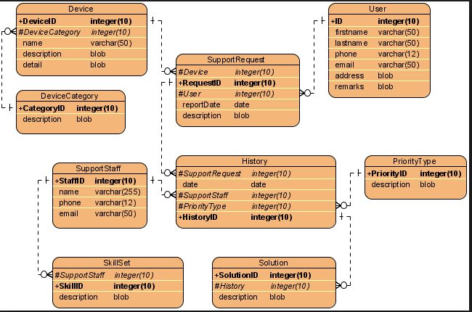
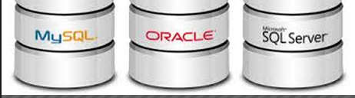
Entity-Relationship Modelling (ERM)
3) Implementation :
ERM –> Create tables with constraints; for example:
Enter data →Database

Slide 29
End of Topic 5

Slide 30
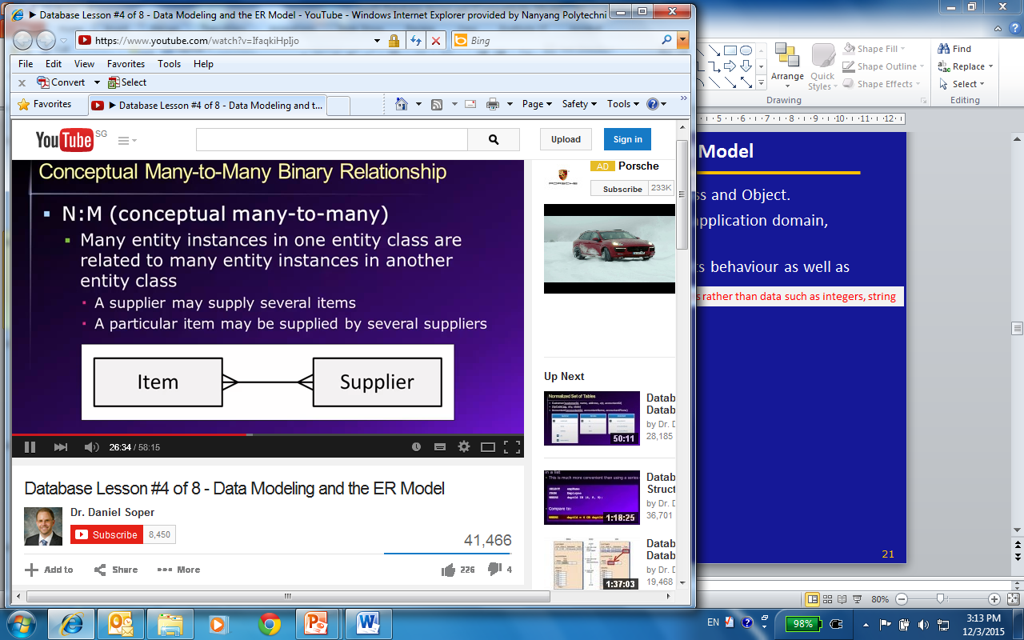
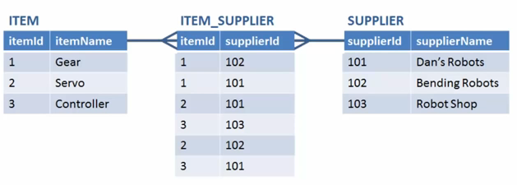
Entity-Relationship Modelling (ERM)
Additional Example,
Key attributes :
ITEM entity – ‘itemid’, SUPPLIER entity – ‘supplierid’

